Slide 1

Requirements and Objectives for holistic PLM

Slide 2
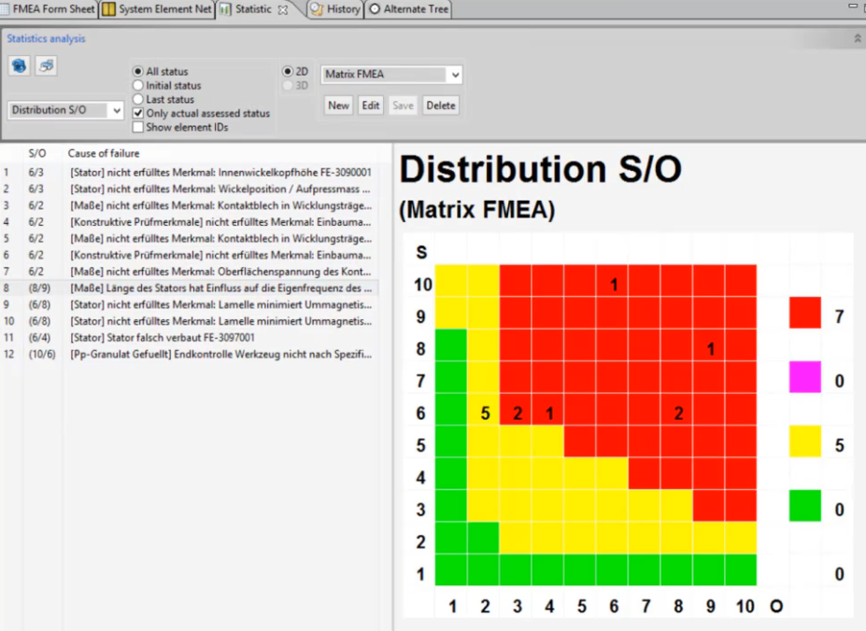


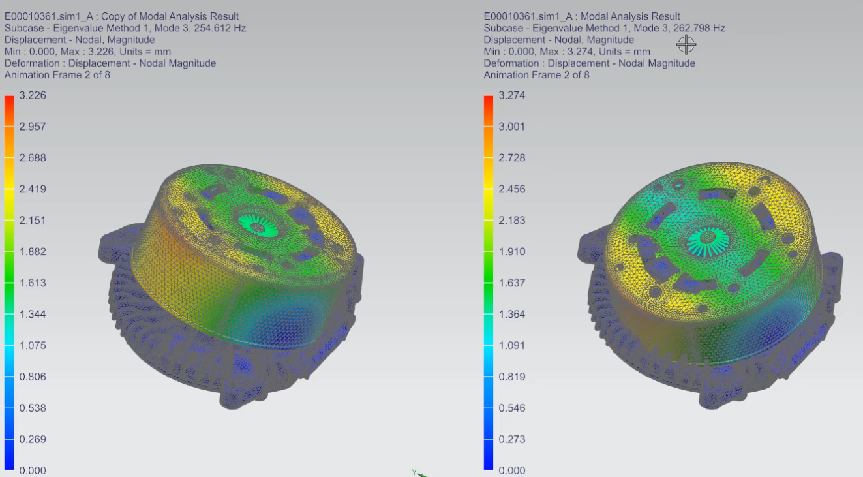
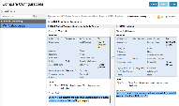
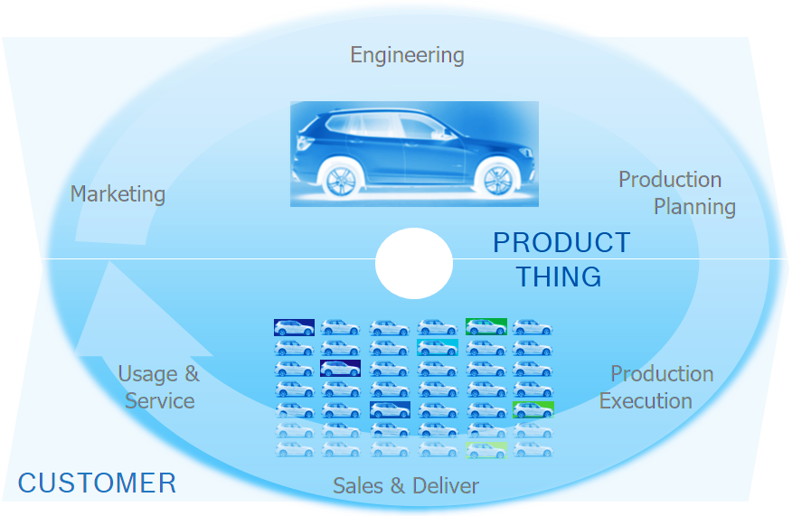
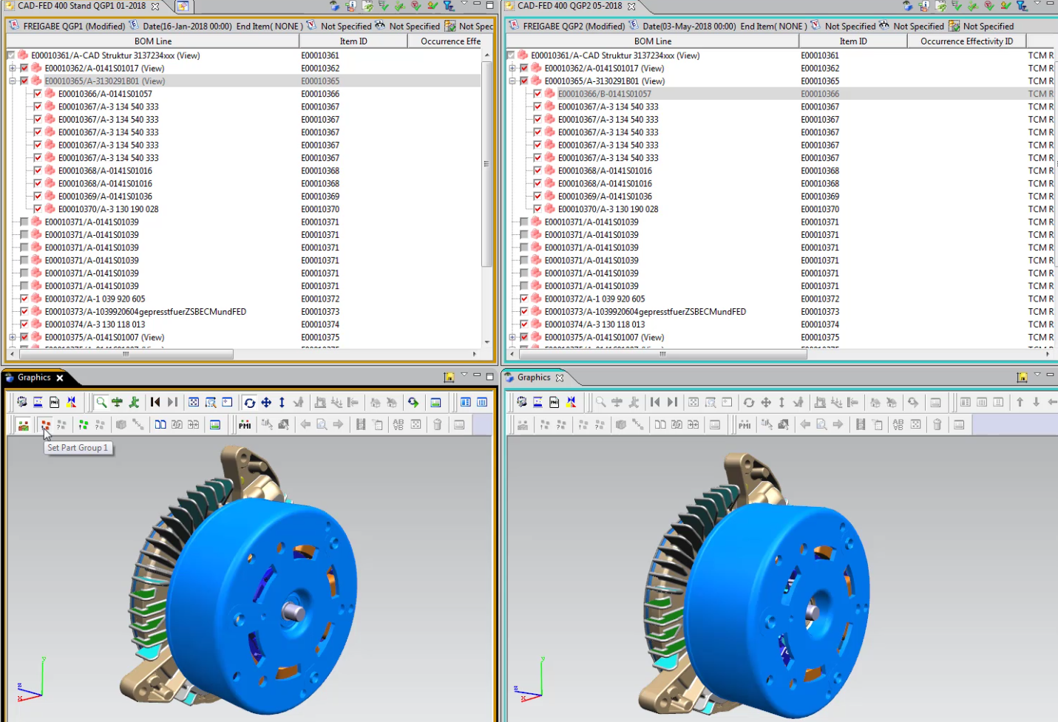
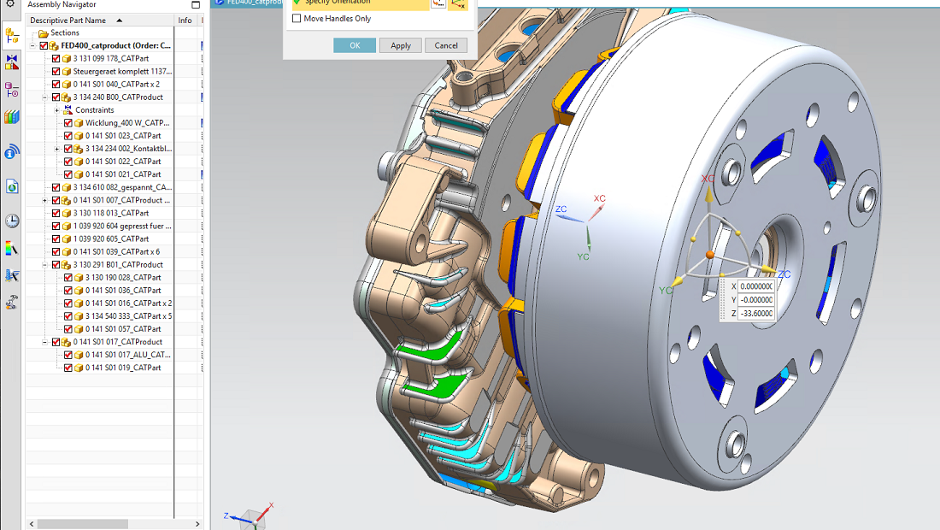
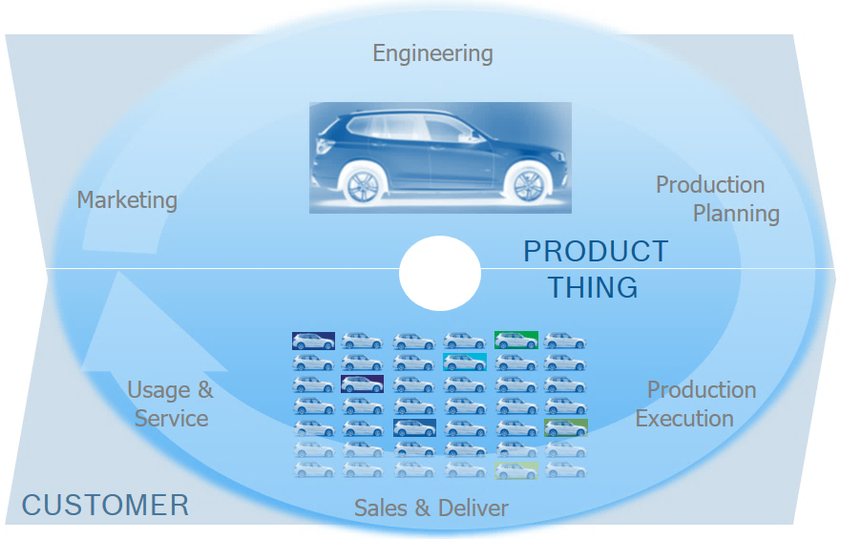



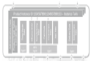
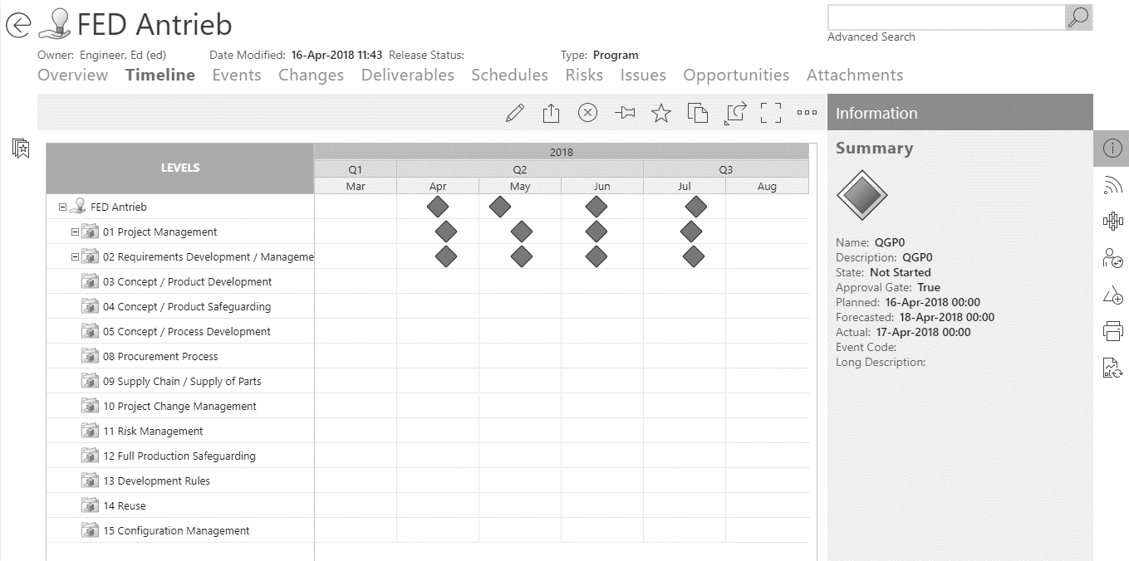
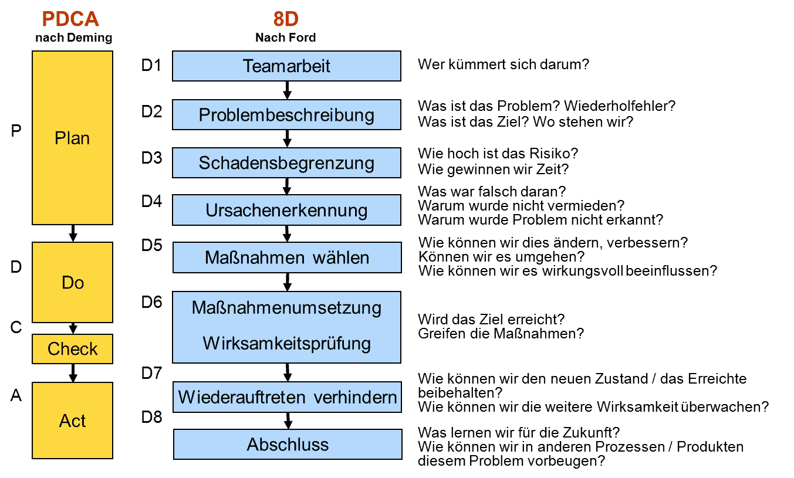
1. Vision | Example: Field data analytics & usage
Requirements and Objectives for holistic PLM
Testing
FMEA
Functions, Severity,
Failure net,
Probabilities
Test cases, Test plan, Environment, Acceptance, Criteria, Test results
Simulation
Parameter data, Model,
Simulation result, Validation data,
Software version
Specification
Requirments, Offer, Platform, Variant, Criterias,
Customer
Production planing
Working & testing step
Cycle time
Maschine occupancy
Plant, lines, equipment
M/EE/SW Model-based Engineering
Base lines,
Release version, Geometry, Functions, Requirments Rules
OEM
Production
Production Date,
Final test result,
Machine-ID,
Process Parameter
IoT
Service Request, Environment data, Usage data, System failure, Customer changes
Deliver
Quality Management
Delivery note, Plant,
Customer, Quantity,
Transport chain
8D-Report, Failure, Root cause,
Risk management, Affected quantity,
Measures,

Slide 3
1. Starting Point & Journey

Slide 4
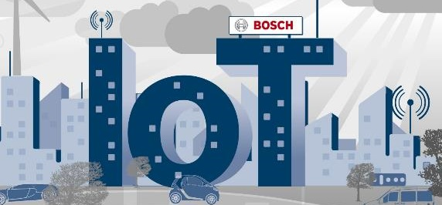
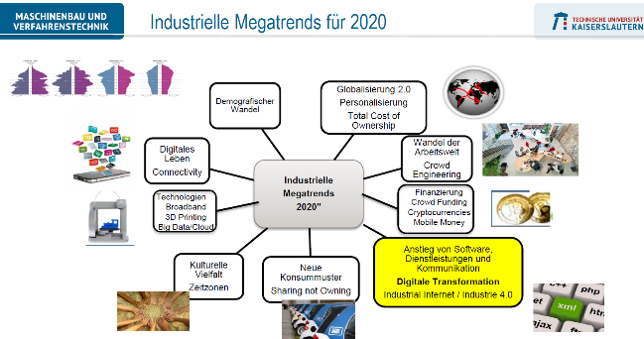
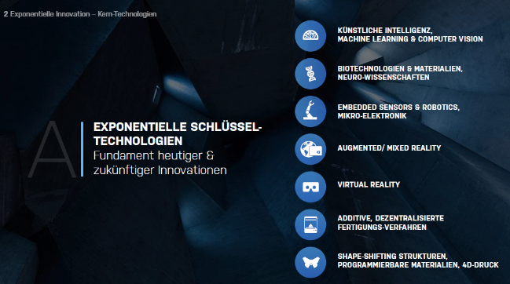

An Industrial Change and the Role of Engineering IT
Requirements and Objectives for holistic PLM
Megatrends
Technology Innovations
Bosch Vision
Our strategic target for all of our electronic product categories is to be IoT-enabled by 2020.
Goal: Deliver the right Engineering IT capabilities to support the Digital Transformation
of the BOSCH business units right in time.

Slide 5



Engineering IT Approach
Requirements and Objectives for holistic PLM
Approach:
Derive the ITE capabilities from the business unit´s digitization challenges
1
2
3
GE challenges
Trends & Technologies Analysis
ITE capabilities
Data is the new oil
From IT tool architecture and component view …
… to data value streams and standards with a system view.
Intelligent products
ACE
Collaboration & Supply Chain Management
Collaboration gets key
Cultural Change & agile Organisation
End-to-End processes in Development
Big Data Mgmt & analysis
Digital business models for production & service
UX for Generation Y
92
Trends &
Technologies
6
Cluster

Slide 6
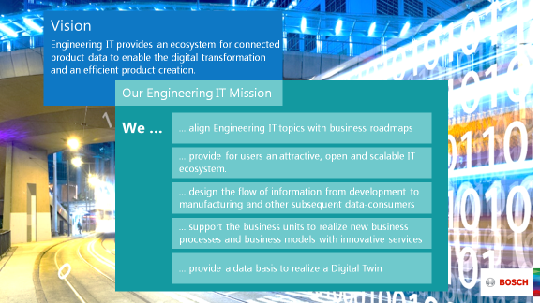

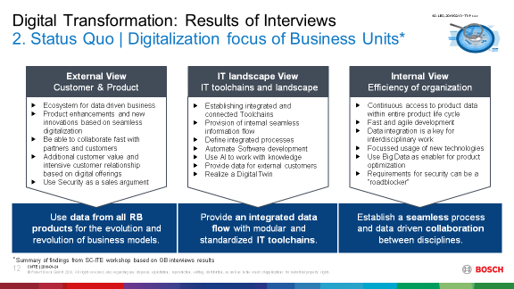

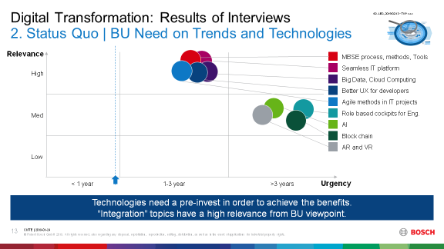

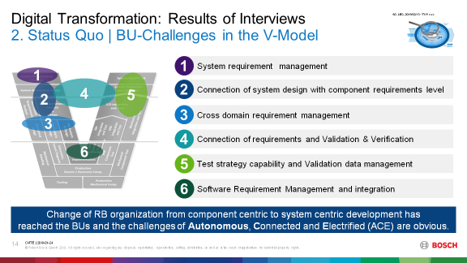

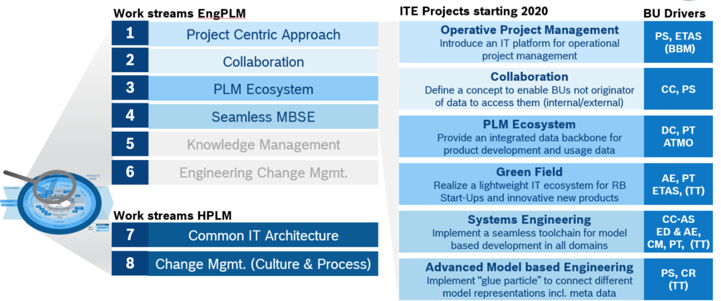
Methodology and Results
Requirements and Objectives for holistic PLM
Definition ITE role within
Digital Transformation
1 new Vision/Mission
92 Trends und Technologies
11.2017
Interviews in BOSCH BUs
01.2018
57 NE-/AL-Level Interviews
Digitalization
Goals
Analysis and Definition of “true north”
05.2018
Trends & Technologies
Development of a Engineering Digitalization Roadmap
07.2018
Model Based
Challenges
Definition (Engineering) PLM Programm with Workstreams
08.2018
1 PLM Programm
8 Workstreams
12.2018

Slide 7
2. Results of Interviews

Slide 8
Digitalization focus of Business Units¹
Requirements and Objectives for holistic PLM
External View
Customer & Product
IT landscape View
IT toolchains and landscape
Internal View
Efficiency of organization
Ecosystem for data driven business
Product enhancements and new innovations based on seamless digitalization
Be able to collaborate fast with partners and customers
Additional customer value and intensive customer relationship based on digital offerings
Use Security as a sales argument
Establishing integrated and connected Toolchains
Provision of internal seamless information flow
Define integrated processes
Automate Software development
Use AI to work with knowledge
Provide data for external customers
Realize a Digital Twin
Continuous access to product data within entire product life cycle
Fast and agile development
Data integration is a key for interdisciplinary work
Focussed usage of new technologies
Use Big Data as enabler for product optimization
Requirements for security can be a “roadblocker”
Use data from all RB products for the evolution and revolution of business models.
Provide an integrated data flow with modular and standardized IT toolchains.
Establish a seamless process and data driven collaboration between disciplines.
¹ Summary of findings from SC-ITE workshop based on GB interviews results

Slide 9
Assessment of Technologies (given)
Requirements and Objectives for holistic PLM
Relevance
MBSE process, methods, Tools
High
Seamless IT platform
Big Data, Cloud Computing
Better UX for developers
Med
Agile methods in IT projects
Role based cockpits for Eng.
AI
Block chain
Low
AR and VR
< 1 year
1-3 year
>3 years
Urgency
today
Technologies need a pre-invest in order to achieve the benefits. “Integration” topics have a high relevance from BU viewpoint.

Slide 10
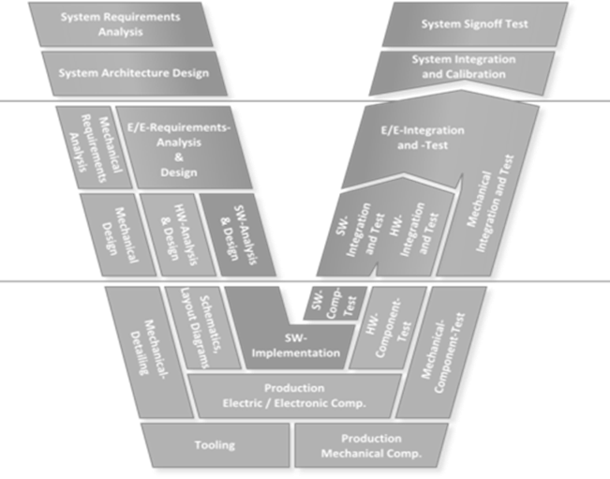
BU-Challenges in the V-Model
Requirements and Objectives for holistic PLM
1
System requirement management
1
5
2
4
2
Connection of system design with component requirements level
3
Cross domain requirement management
3
4
Connection of requirements and Validation & Verification
6
5
Test strategy capability and Validation data management
6
Software continuous integration, validation & deployment
Change of organization from component centric to system centric development has reached the BUs and the challenges of Autonomous, Connected and Electrified (ACE) are obvious.
Notes:
Change of RB organization from component centric to system centric development has reached the BUs and the challenges of ACE are obvious.

Slide 11
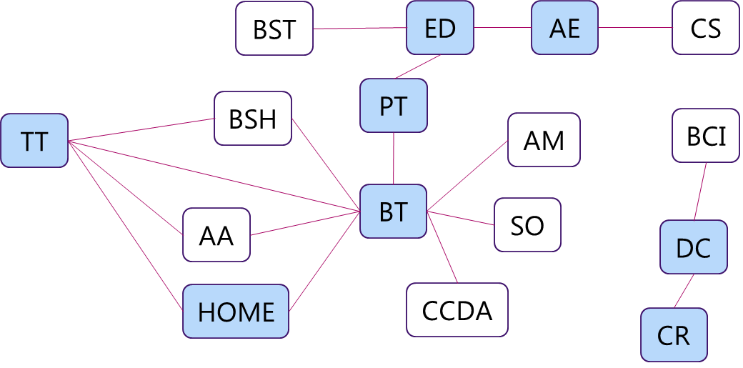
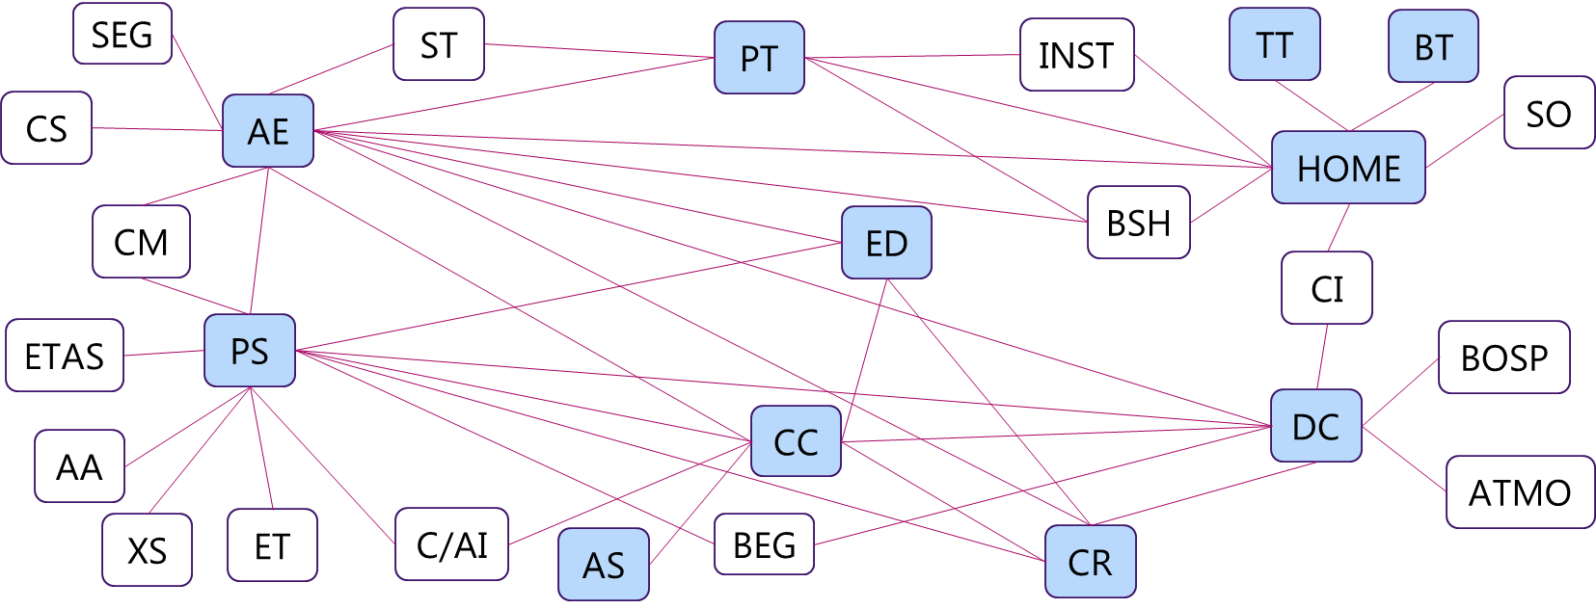
Collaboration and initiatives in the BUs
Requirements and Objectives for holistic PLM
Future wish for collaboration between BUs
Today´s view on collaboration
between BUs
Collaboration does not happen in pre-defined eco-systems.
An efficient collaboration requires standards, transparency on projects, technologies, contacts etc. .

Slide 12
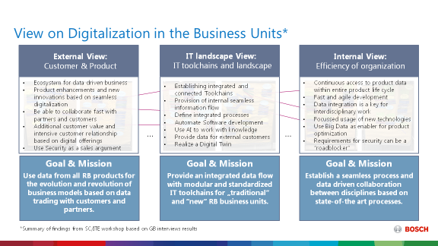
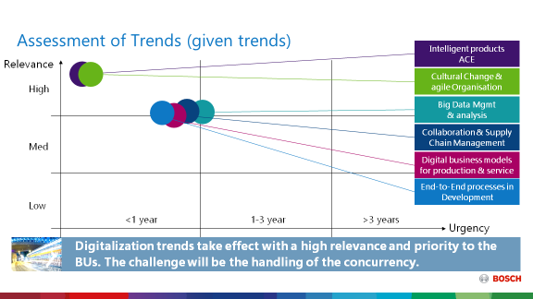

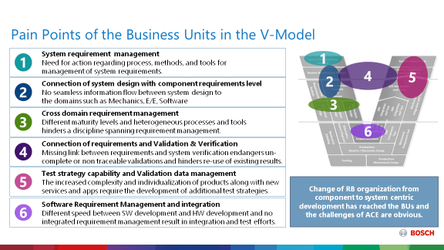

Towards an ITE True North and Roadmap
Requirements and Objectives for holistic PLM
BU Pain Points
Digitalization
Goals
112 Obstacles and
Missing capabilities
Trends & Technologies
ITE True North
Model Based
Pains
36 not influence able
25 Forwarding to other
51 relevant ITE topics
Many BU pain points are based on existing tool landscape. Many topics are difficult to implement in current architecture.

Slide 13
3. Conclusion

Slide 14
Guiding Principles from a Bosch Perspective
Requirements and Objectives for holistic PLM
Seamless toolchains, openness, standards and UX are key success-factors,
in a federative, non monolithic IT environment
Benefit for BU users in a short timeframe should prioritize project topics.
Seamless toolchains are as important as functional tool excellence.
Tools follows process is not in every situation the best solution for BOSCH. Sometimes a process adoptions deliver faster benefit for the users.
Usability is a key for the success of the solution with all users (not only engineering)
Standards should be used were available or have to be developed
Openness of vendors is important. ProStep IVIP CPO gives a guideline.
Overcoming established working procedures and decision principles will be one of the top
challenges in engineering digitalization !

Slide 15
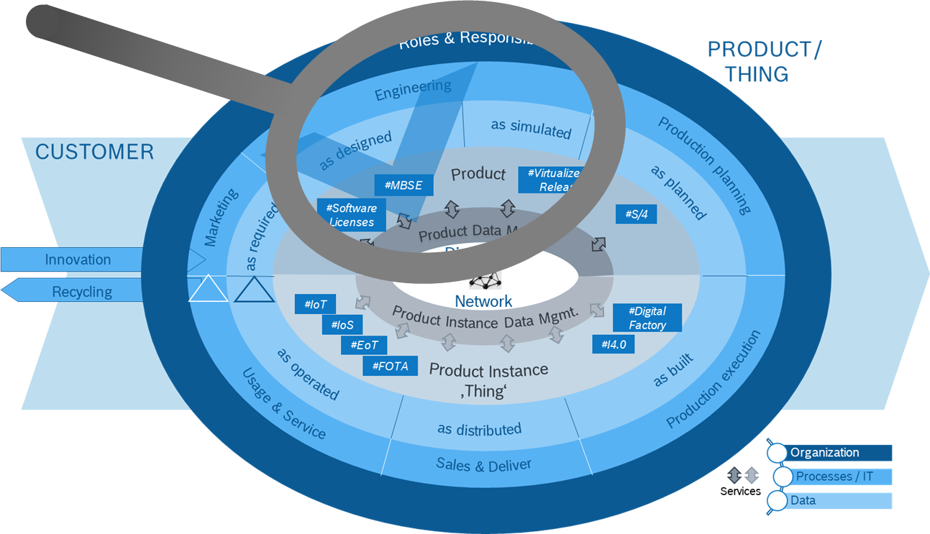
Engineering PLM & HPLM
Requirements and Objectives for holistic PLM
Work streams Engineering PLM
Engineering Projects starting
prioritized from 36 proposals
1
Project Centric Approach
Operative Project Management
Introduce an IT platform for operative project management i.e. intuitive dashboards etc.
2
Collaboration
Collaboration
Easy, transparent and secure access to product and instance data for people and processes
3
PLM Ecosystem
4
Seamless MBSE
PLM Ecosystem
Foster reuse of data along the entire value chain and provide the basis for digital driven business
5
Knowledge Management
6
Engineering Change Mgmt.
Green Field
Realize a lightweight IT ecosystem for RB Start-Ups and innovative new products
Work streams HPLM
Systems Engineering
Implement a seamless toolchain for model based development in all domains
7
Common IT Architecture
8
Change Management (Mindset, People, & Processes)
Advanced Model based Engineering
Implement “glue particle” to connect different model representations incl. meta data

Slide 16
Objectives & Conclusion
Requirements and Objectives for holistic PLM
Collaboration
Federative Architecture
Traceability
Establishment of a collaboration platform (internal/external, cross-disciplinary) to manage the increasing product and process complexity.
Creation of a federal IT architecture (no monolith) for configuration management of
product and product instances.
Creation of an automated, data model-based traceability and retrieval with “one mouse click”.
Model & Systems oriented Approach
Connectivity
Cultural Change and Governance
System-driven management of interdisciplinary engineering procedures and model based information flow are key aspects.
Generation of standardized and networked data models in the Digital Core Network as a basis for model-based work and automated, inter-connected processes
HPLM is firmly anchored in the organization and the disruptive change is continuously implemented through a GF-supported change process.
Modern PLM approaches connect data/models from multiple enterprise disciplines.
By doing so, for the first time we establish a holistic management of the product lifecycle

Slide 17
Thank You for Your Attention

Slide 18
Assessment of Trends (given)
Requirements and Objectives for holistic PLM
Relevance
High
Intelligent products ACE
Cultural Change & agile Organisation
Med
Big Data Management & analysis
Collaboration & Supply Chain Management
Digital business models for production & service
Low
End-to-End processes in Development
< 1 year
1-3 year
>3 years
Urgency
Digitalization trends take effect with a high relevance and priority to the BUs. The challenge will be the handling of the concurrency.

